Slide 1


PRESENTATION
WWW.LIYTECH.COM

Slide 2


1- Brief Introduction.
2- Production Facility.
3- Testing Facility.
4- Existing Products.
5- Main OEM Customers.
CONTENTS

Slide 3

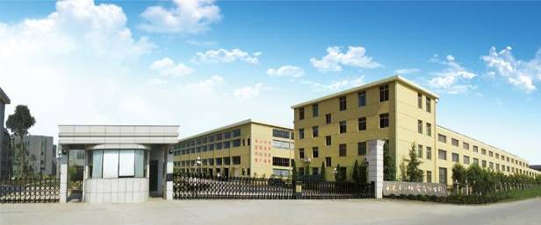
BRIEF INTRODUCTION
2004
Zhejiang LIYTECH Co.,Ltd Established in May 2004, LIYTECH has rapidly grown up, currently covers 80,000 square meters area and 120,000 square meter construction area . We have modern industrial workshop with first-class production and testing devices, meanwhile we have a group of professional engineers, senior managers and technology staffs. Now LIYTECH has more than 420 employees.We have sold more than 150,000 snowblower annually since 2010.
Benefiting from advanced innovation capability, reasonable management system and good service attitude, LIYTECH has rapidly grown into a leading enterprise in the domestic industry during the development of past 19 years.
With good business reputation ,continuous revolution ability and persistent pursuit of high-quality, We have Extensive and in-depth cooperation with many well-known supermarkets, department store chain, distributor and landscape brand manufacturer.
SINCE
80,000
COVERAGE
120,000
CONSTRUCTION AREA
420
EMPLOYEE

Slide 4

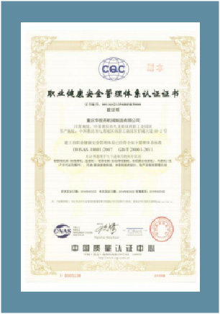
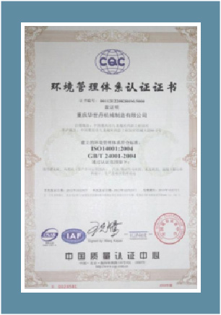
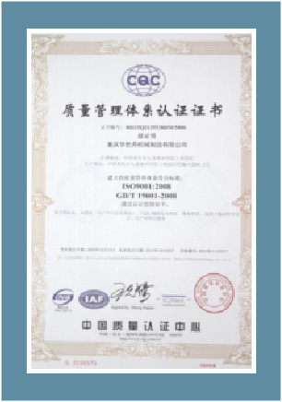

MANAGEMENT SYSTEM CERTIFICATION
OHSAS 18001
国际健康&安全管理体系
ISO14001
国际环境管理体系
ISO9001
国际质量管理体系
CE,EU II, SONCAP, AND
EU-V, EPA,CARB.

Slide 5
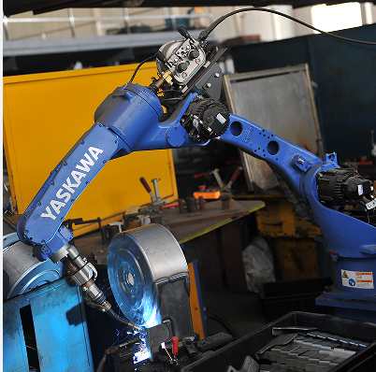
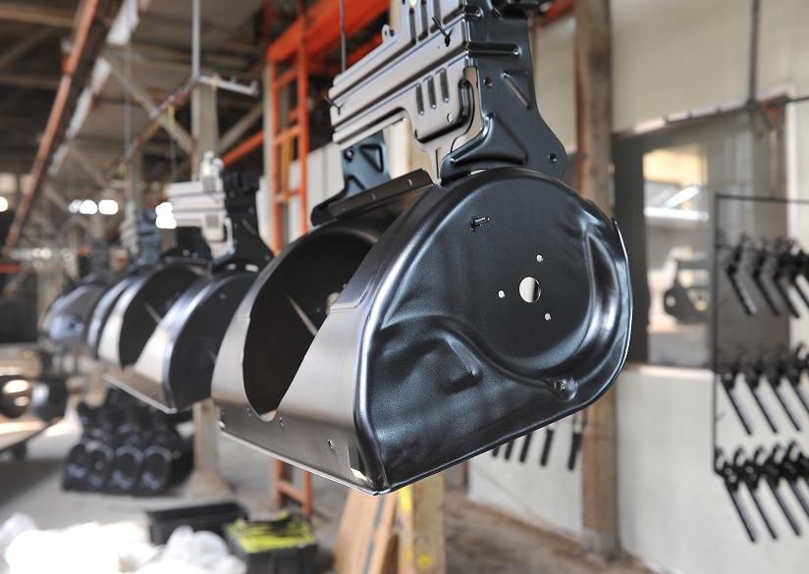
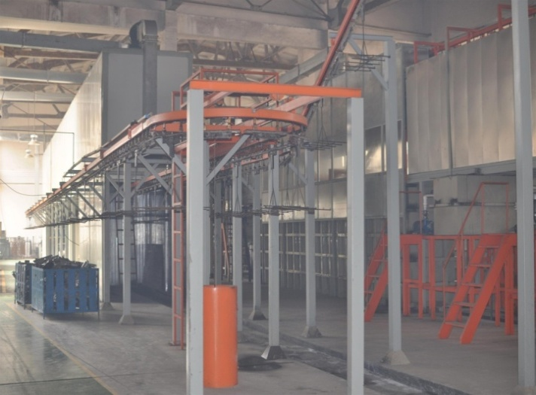
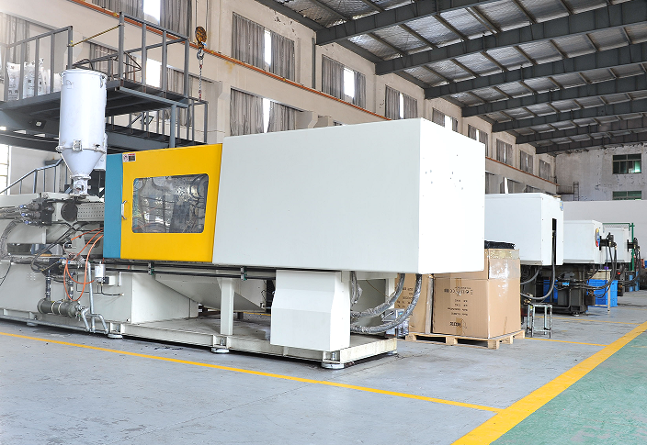
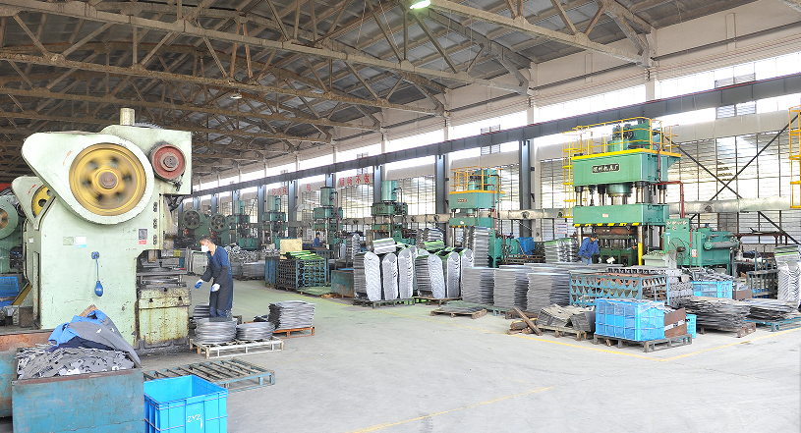
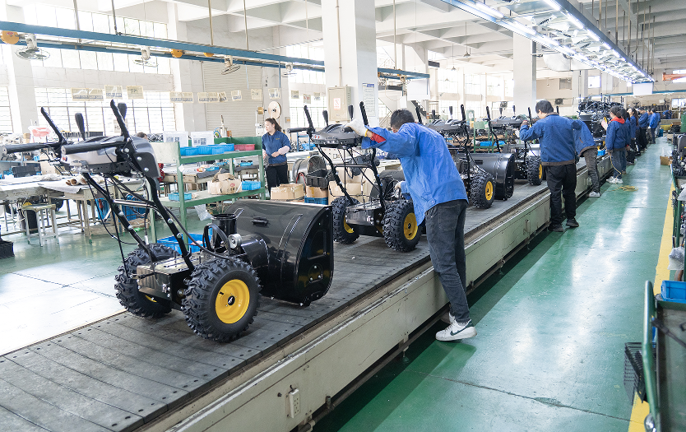
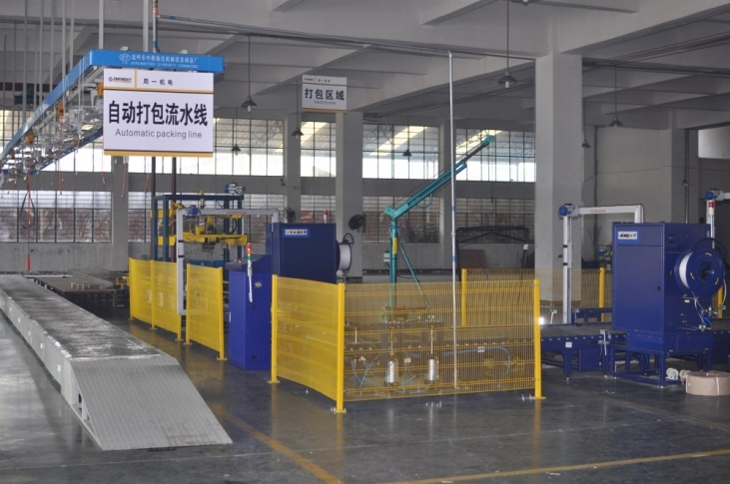
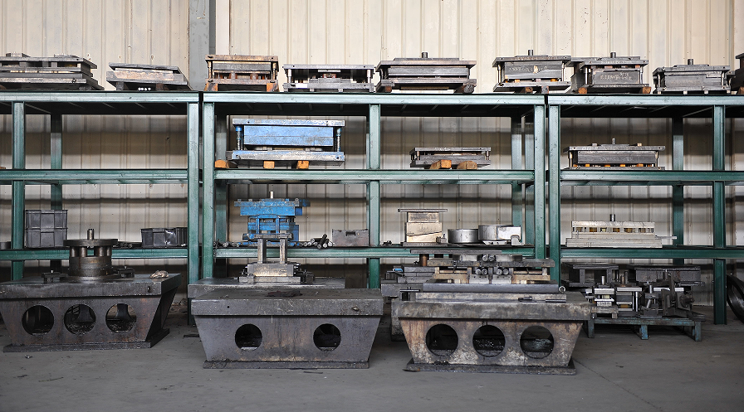
KEY COMPONENTS PRODUCED IN HOUSE
COVER 100,000 SQUARE METERS
8 ROBOT WELDING
2 ROBOT POWDER PAINTING LINES
E-COATING
12 INJECTION MACHINES
16 HYDRAULIC PUNCHING
7 ASSEMBLY LINES
4 AUTOMATIC PACKING LINES
TOOLING CENTRE

Slide 6
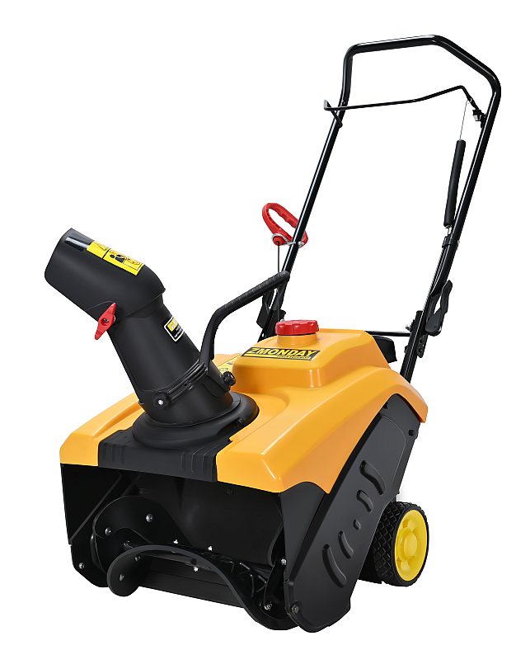
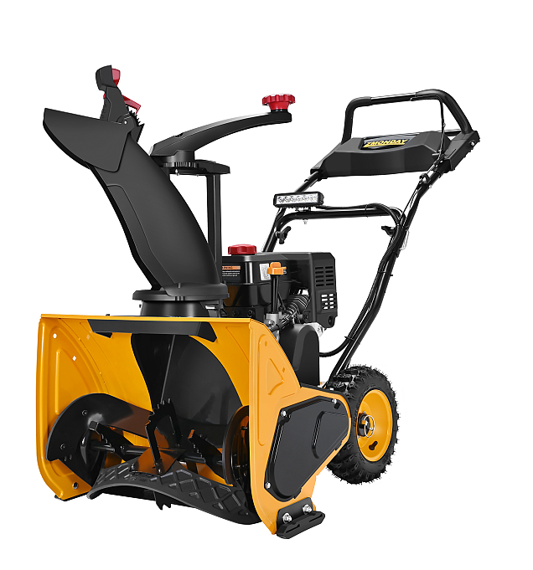
SINGLE STAGE SNOW
THROWER RANGE
Model:
Model:
STD8718
STD7060
Engine:
Engine:
Loncin 87cc
Loncin 212cc
Cleaning Width:
Cleaning Width:
46cm/18’
61cm/24’

Slide 7

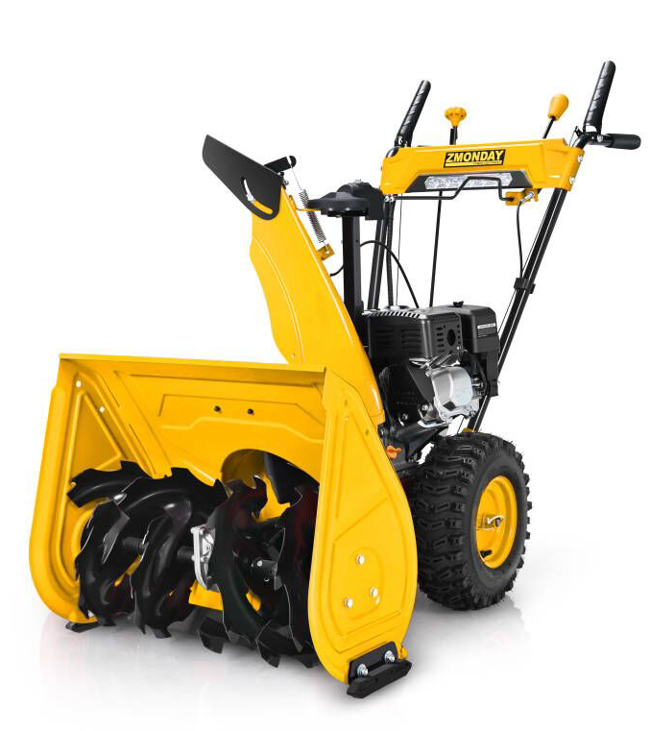
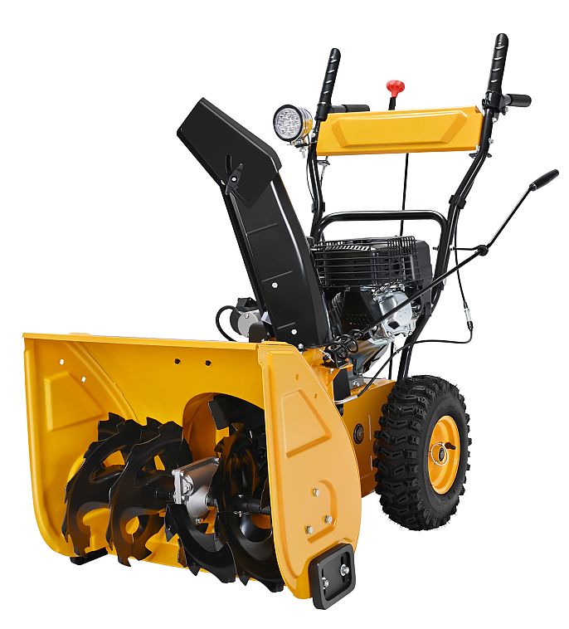
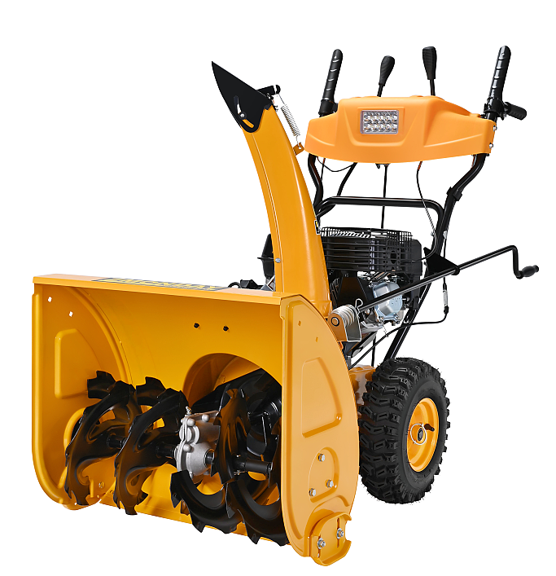
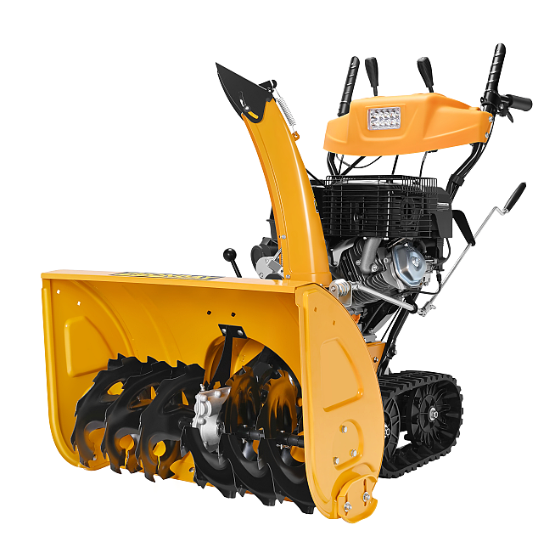
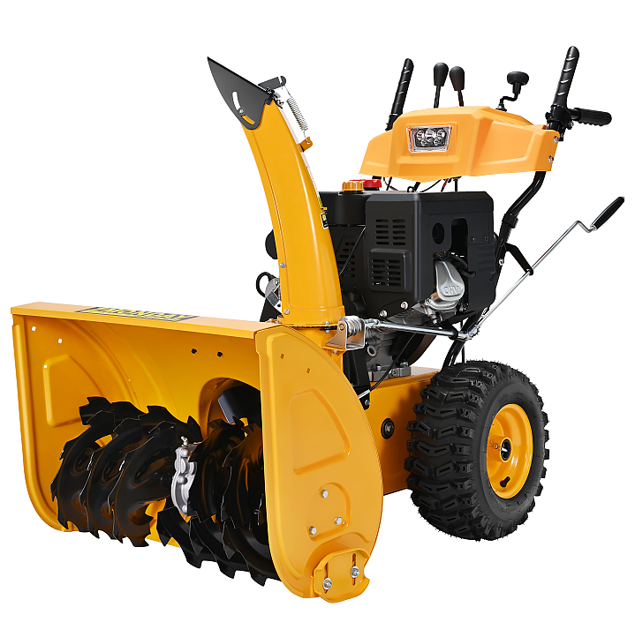
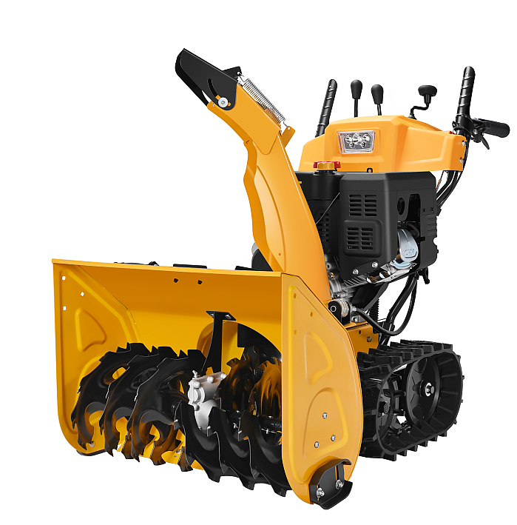
DUAL STAGE SNOW THROWER RANGE
163cc to 420cc , 56CM/22’ to 106.5CM/42’

Slide 8
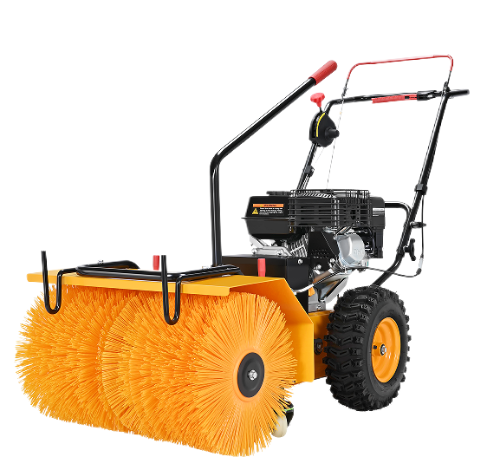
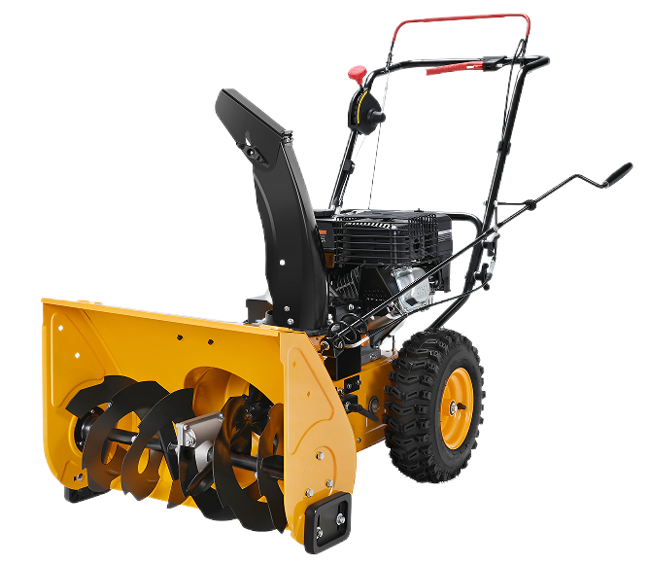
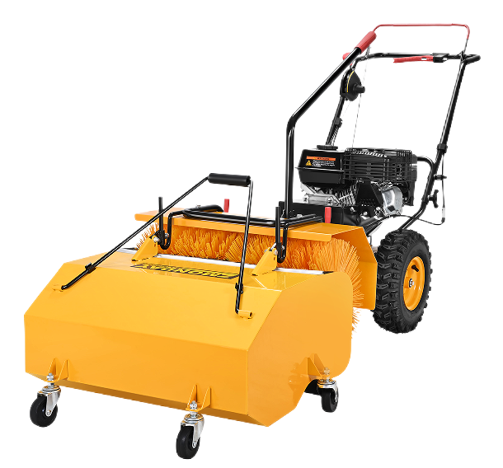
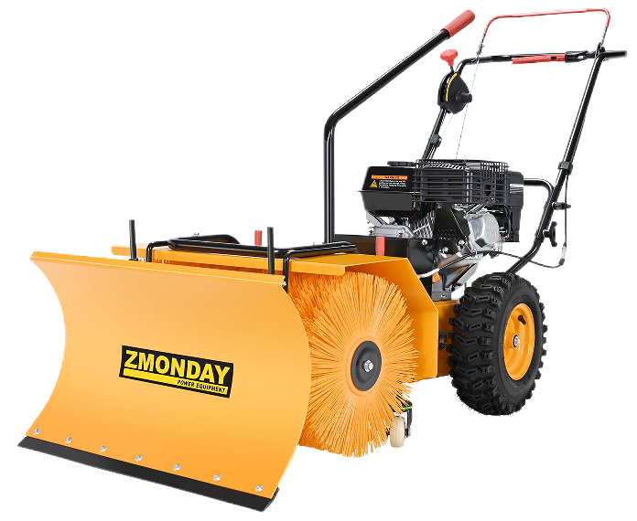
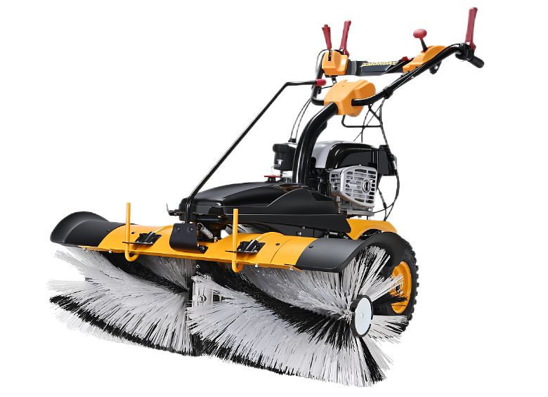
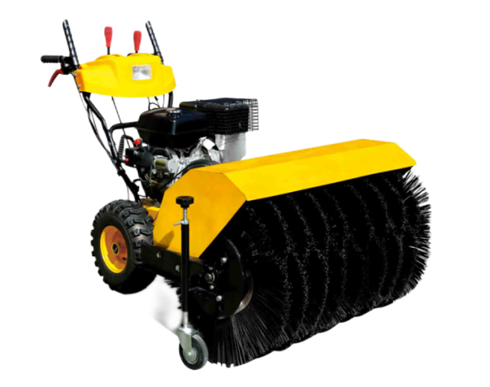
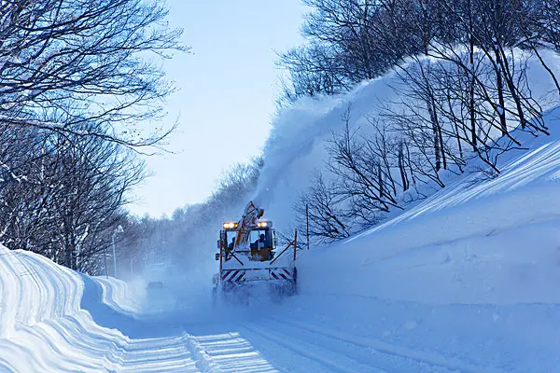
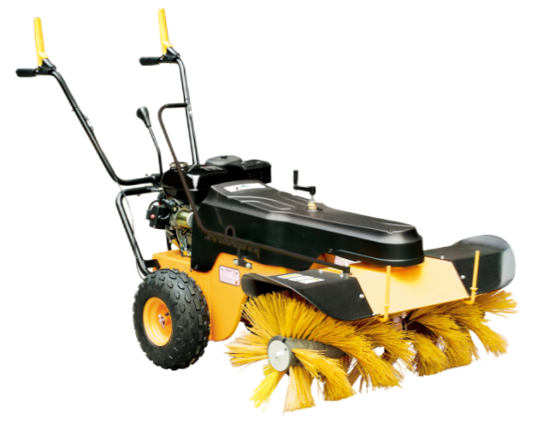
MULTI-FUNTION SWEEPER RANGE
163cc to 375cc, 62CM/24’ to 110CM/40’ width

Slide 9
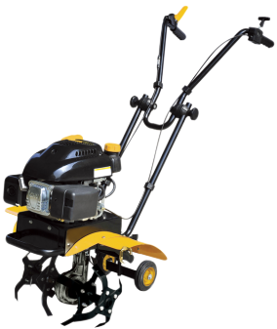
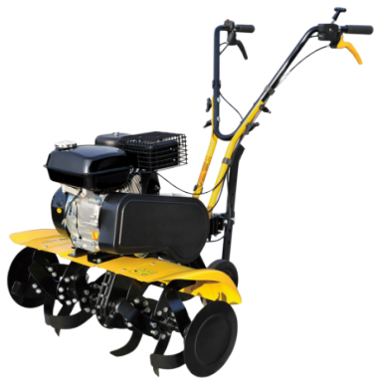
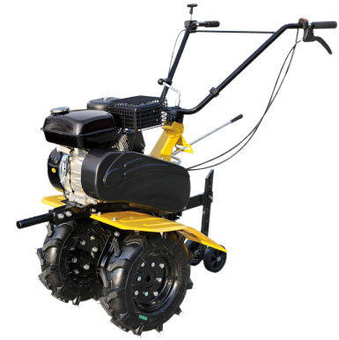
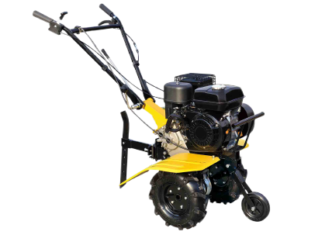

PETROL TILLER RANGE
140cc to 196cc, width 38CM to 80CM

Slide 10
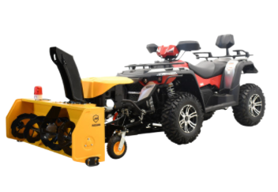
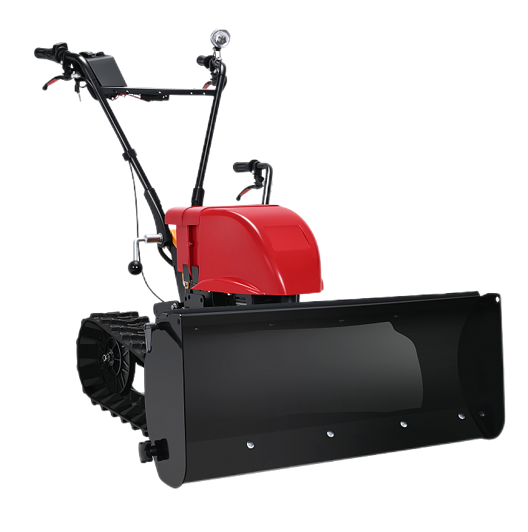
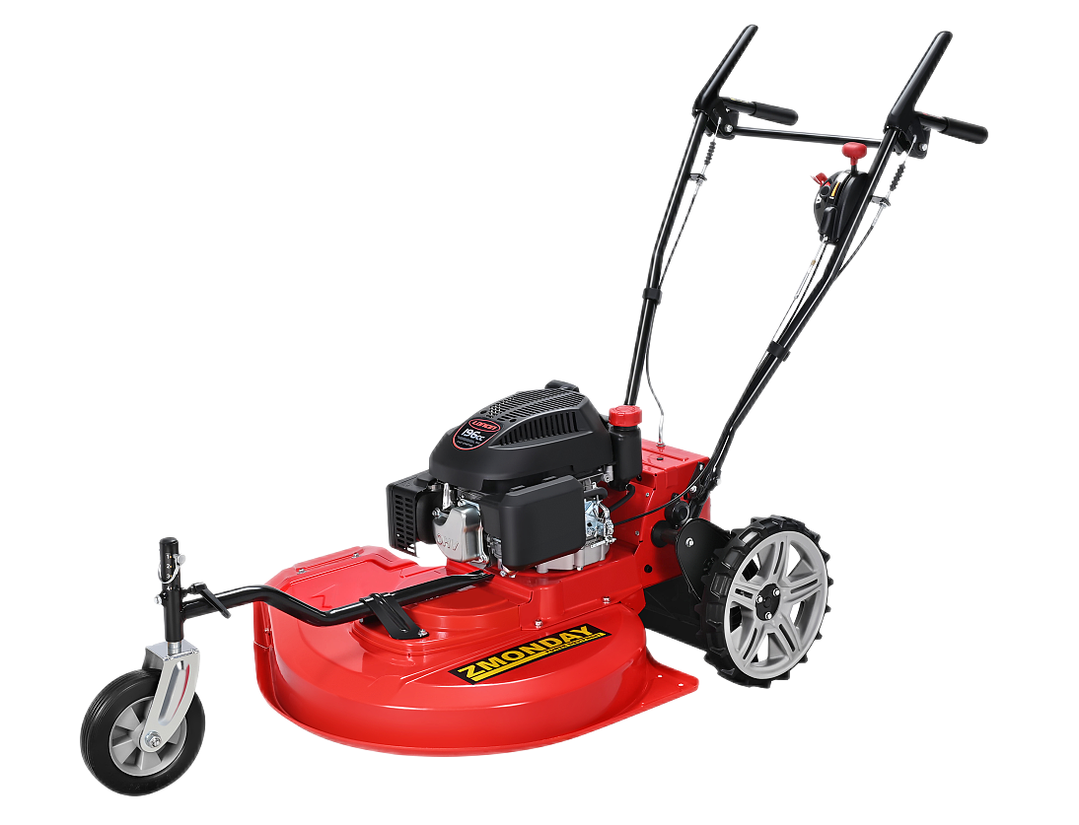
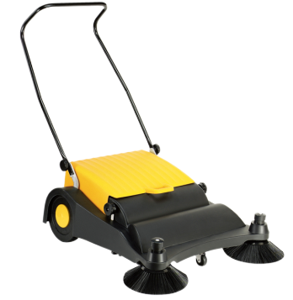
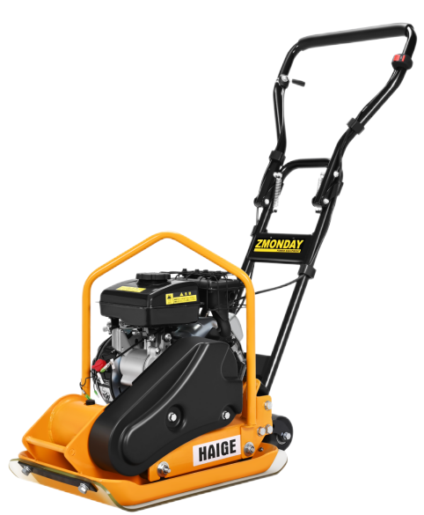
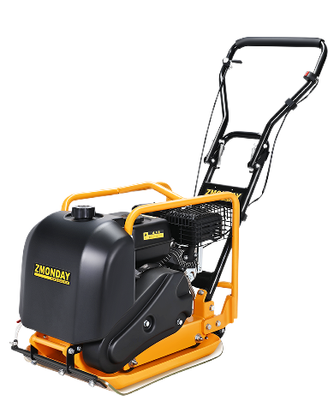
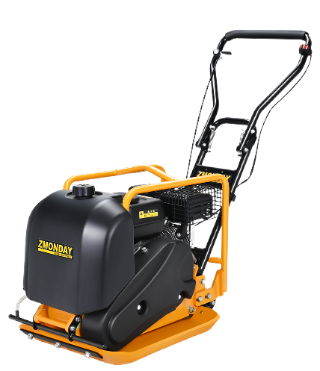
OTHER PRODUCTS RANGE
UTV/ATV Snow Thrower
Electric Snow shovel
Lawn Mower
Manual Sweeper
PLATE
COMPACTOR

Slide 11
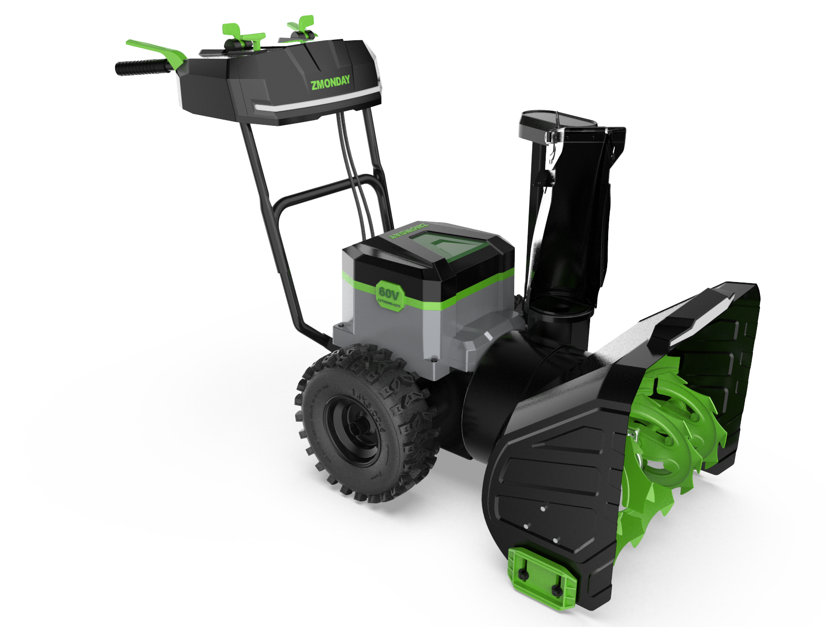
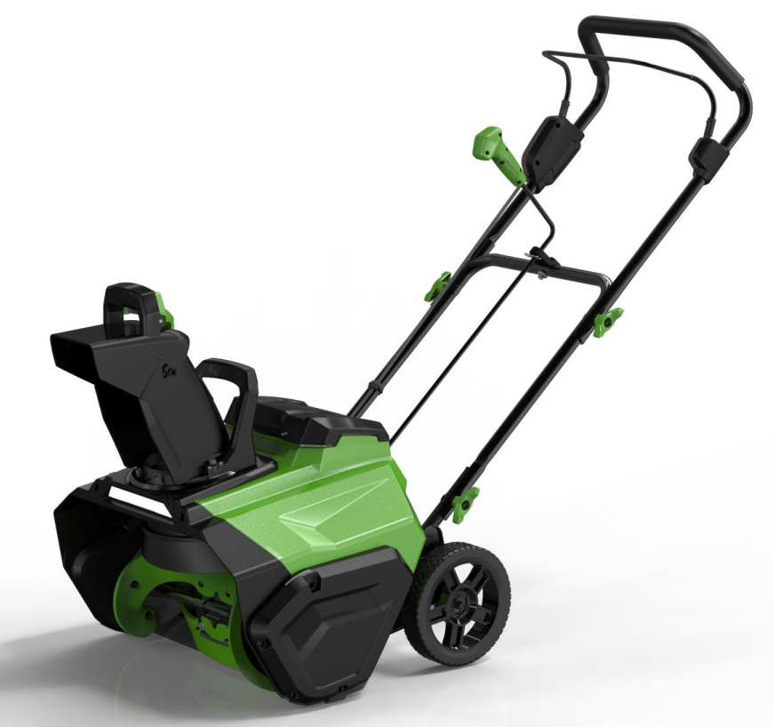
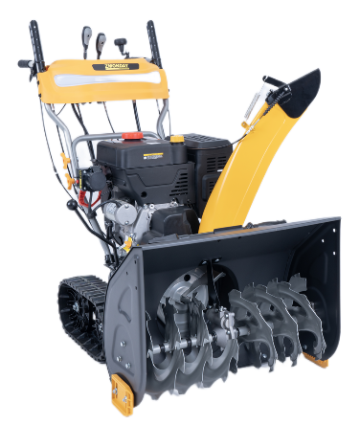
WHAT’S NEW?
Single stage
40V / 20’
Dual stage
40V*2 / 24’

Slide 12
LITHIUM SNOW THROWER
SPECIFCIATION
Voltage : 40V
Battery capacity:4Ah SUNSEEKER
Runtime : 40 minutes no-load running
Quick charger included : YES
Clearing width : 20-inch /508mm
Clearing height : 10-inch /254mm
Wheel size : 8-inch/203.2mm
Auger diameter : 172mm
Auger material : TPU
Auger speed : 2000 rpm
Chute material : HDPE
Brushless motor : 1300W
Waterproof level : IPx4
LED headlight : 1.3W
Discharge chute adjustment : 180±3°
Discharge chute adjustment : Manual
Throw distance : 5-30 feet
snow blower net weight : 19KGS
Package size : 600x580x450mm
Single stage

Slide 13
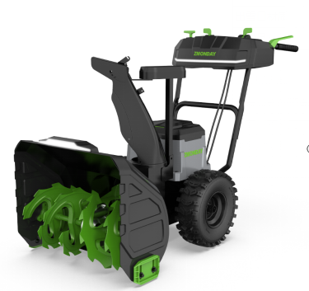
LITHIUM SNOW THROWER
SPECIFCIATION
Voltage : 40V*2
Battery capacity : 4Ah
Rated power of Auger Brushless Motor : 3500 w
Rated power of Hub Brush Motor : 600 w
Runtime : 40 minutes no-load running
Quick charger included : YES
Clearing width : 24-inch /610mm
Clearing height : 21-inch /51mm
Max Throwing Distance : Up to 50'
Auger diameter : 12 "
Auger material : Steel
Auger speed : 80~130 1/min
Chute material : Steel
Wheel size : 14"/15"
Waterproof level : IPx4
LED headlight : YES
Discharge chute adjustment : 180±3°
Discharge chute adjustment : Manual
N.W/G.W(kg) : 65/72kg
Outer carton(cm) : 915*675*760mm
Dual stage

Slide 14
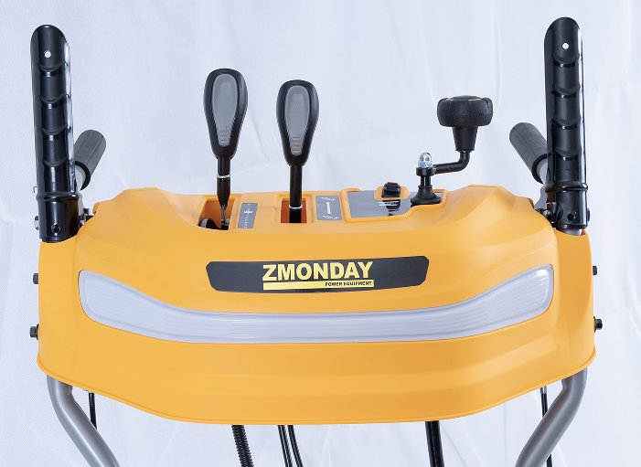
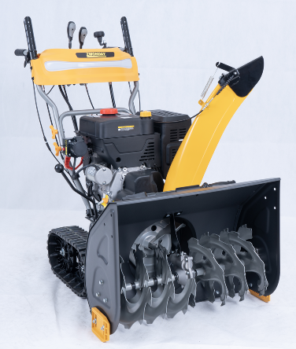
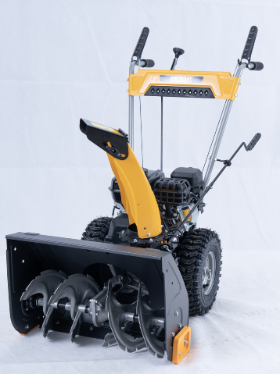
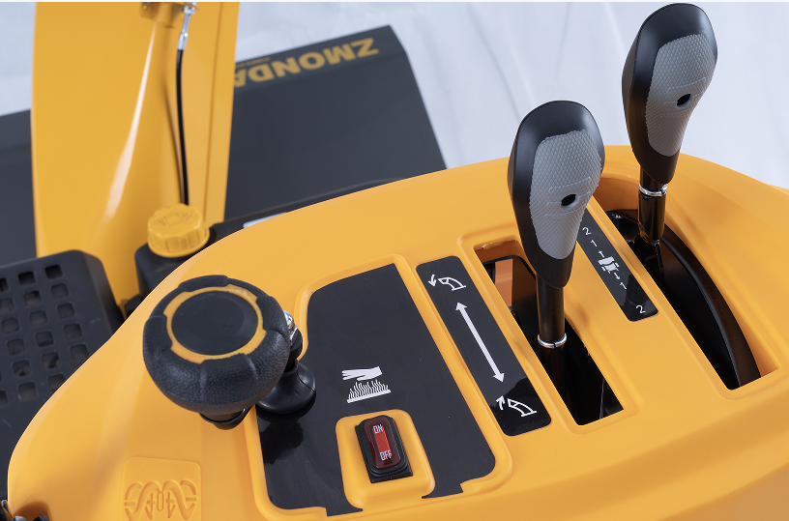
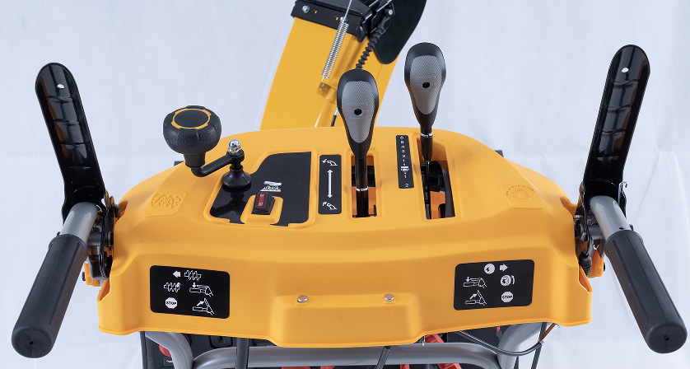
NEW PANEL FOR GASOLINE SNOW THROWER

Slide 15
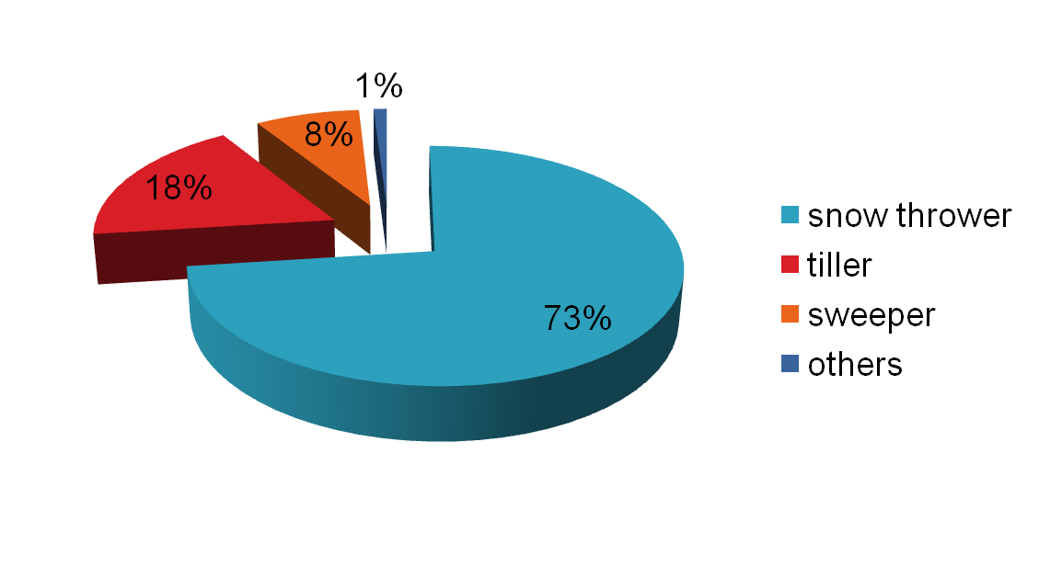
PRODUCTS SALES PROPORTION CHART
73% Snow Throwers
18% Sweepers
8% tillers
1% Others

Slide 16














EUROPE & RUSSIA CUSTOMERS BRAND

Slide 17

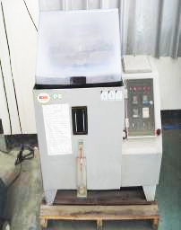





TESTING FACILITY
Salt Spray Chamber
Balance Test
Worm gear box chamber
Large low temperature chamber
Small Low temperature chamber
Friction wheel test

Slide 18

INCOMING QUALITY CONTROL & TESTING LABORATORY
Low temperature lab
Worm gear box test
Friction wheel test
Comprehensive measurement(rubber ring, gear box, cable, spring, plastic part etc)
Spare parts specification & dimension inspection
Spare parts function and performance
Spare parts material analysis

Slide 19

SNOW THROWER STANDARDS.(FINISHED PRODUCTS INSPECTION)
100% Inspection for finished products,And Zmonday testing center will keep each unit inspection record(Like,Engine Series Number,Auger/engine/Tyre/Control lever Speed,Handle height,Auger housing level...)

Slide 20





FIELD TEST

Slide 21





FIELD TEST

Slide 22





FIELD TEST IN HARBIN CHINA

Slide 23

WE ARE JUST ON THE WAY
THANK YOU !
WWW.LIYTECH.COM

